Slide 1


Deep Learning Theory and Applications Loss Landscapes
CPSC/AMTH 663

Slide 2
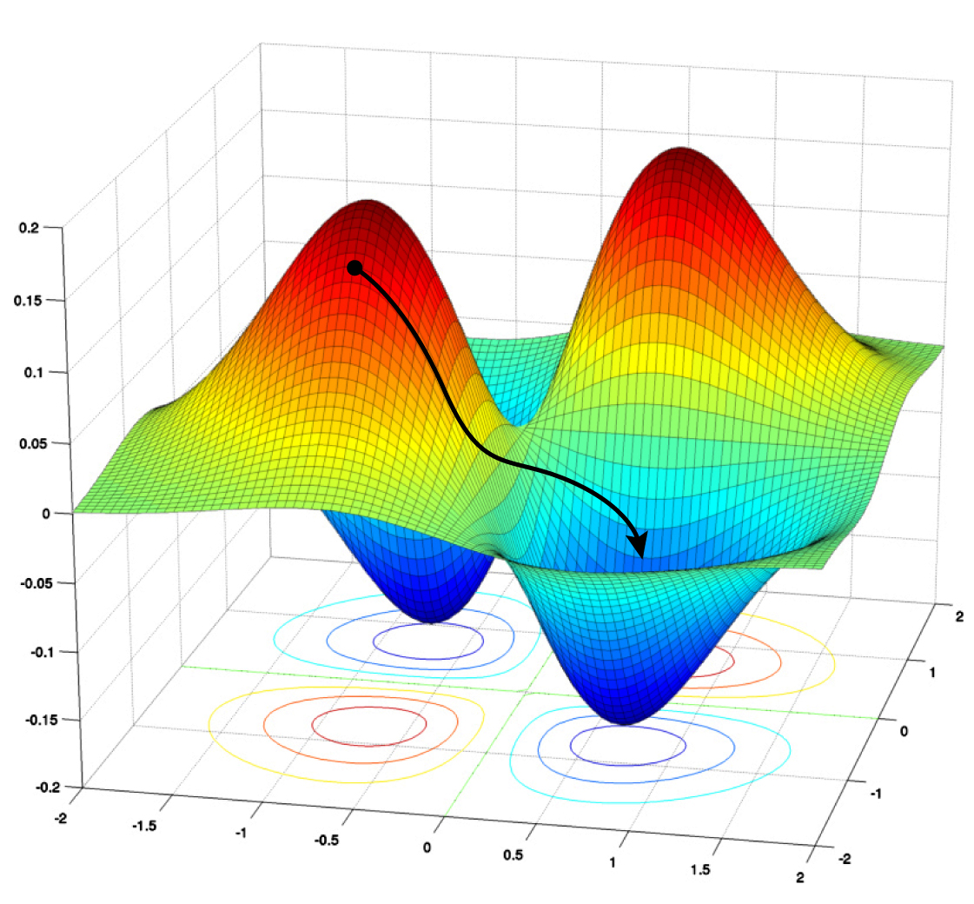
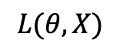
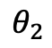
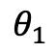
Loss landscape
SGD Path
$$L(θ,X)$$
$$θ_{2}$$
$$θ_{1}$$

Slide 3
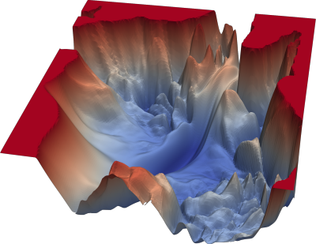
What can it tell us?
If the loss landscape is very bumpy, then there are a lot of local minima
SGD may not reach a good solution, and not very fast

Slide 4
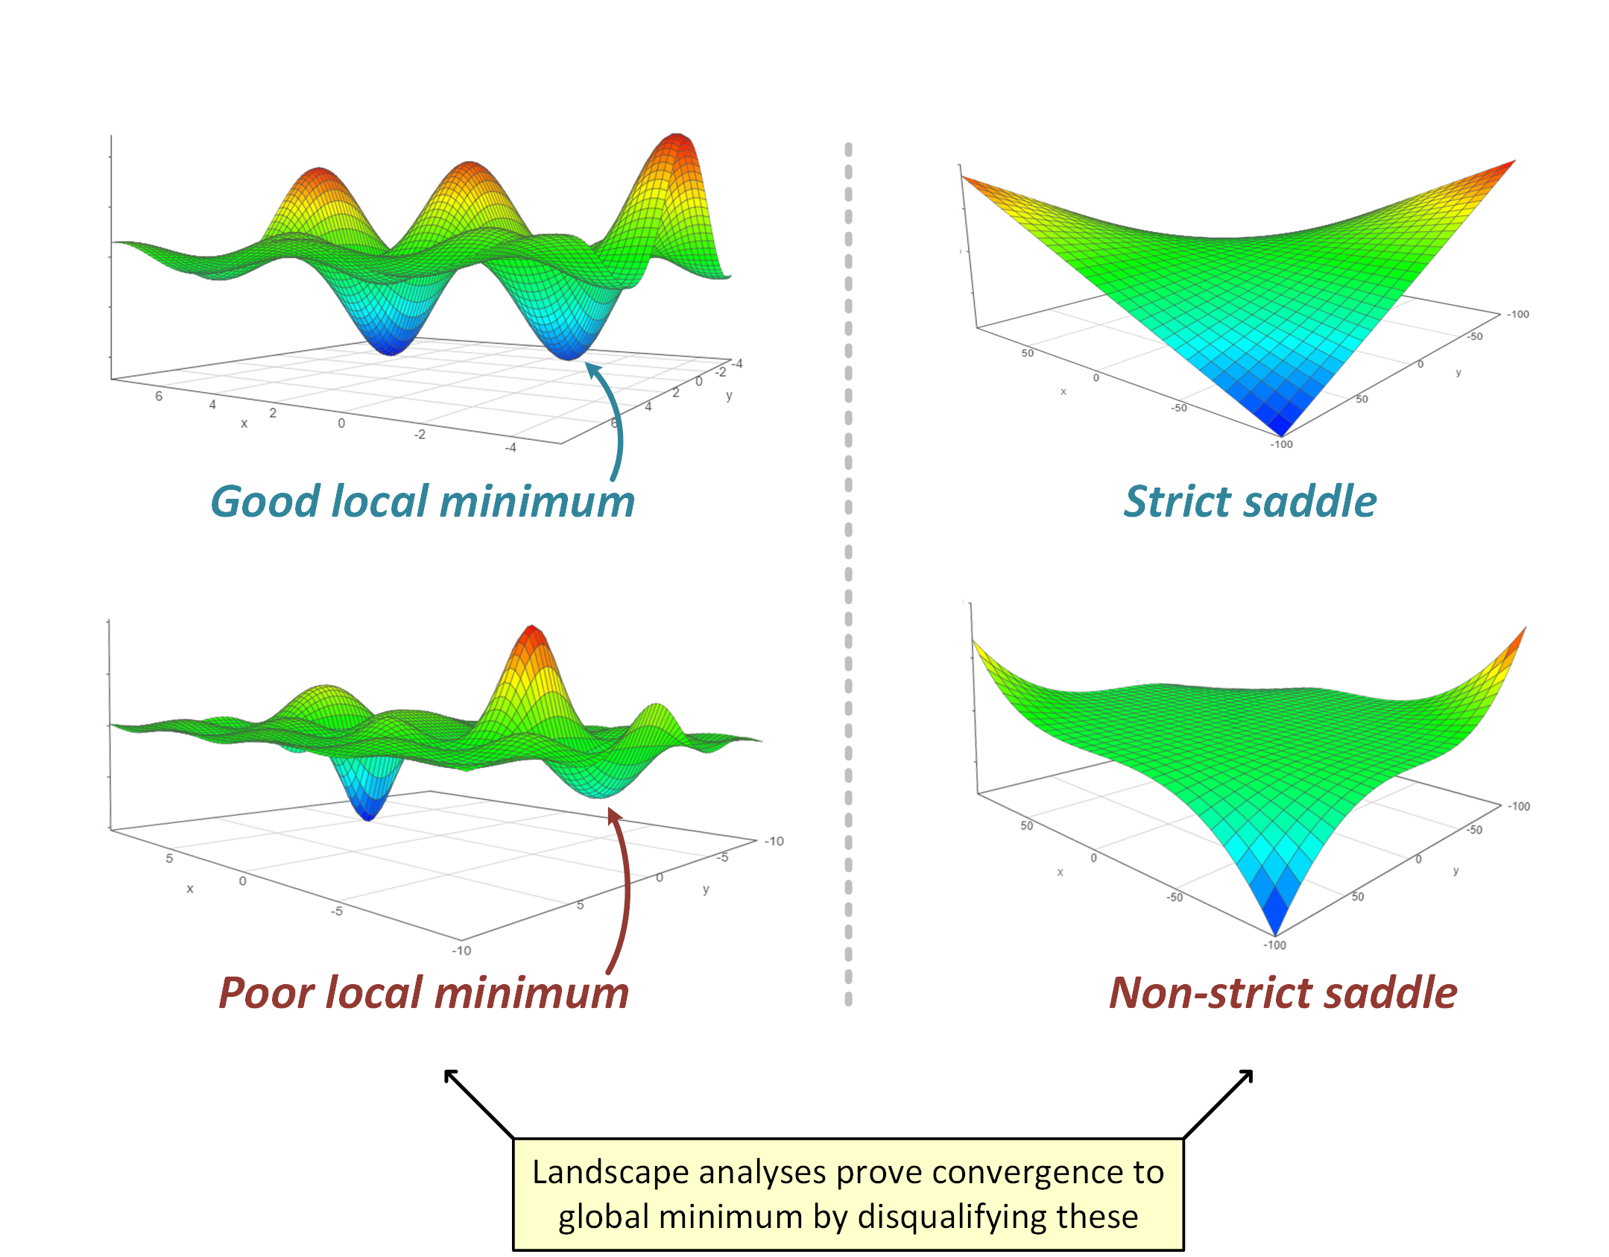
More information from landscapes

Slide 5
Dimensionality of Loss Landscape
Hugely high dimensional space
One ”dimension” for each weight and bias
Difficult to visualize in its entirety
But we can use tricks
Subsampling random directions
Subsampling the landscape around the minima
Random directions to get insight

Slide 6
Random direction visualization
Train a neural network until it gets to a minima
Add a small perturbation in a random direction
See how the loss changes
https://losslandscape.com/explorer

Slide 7
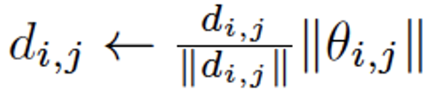
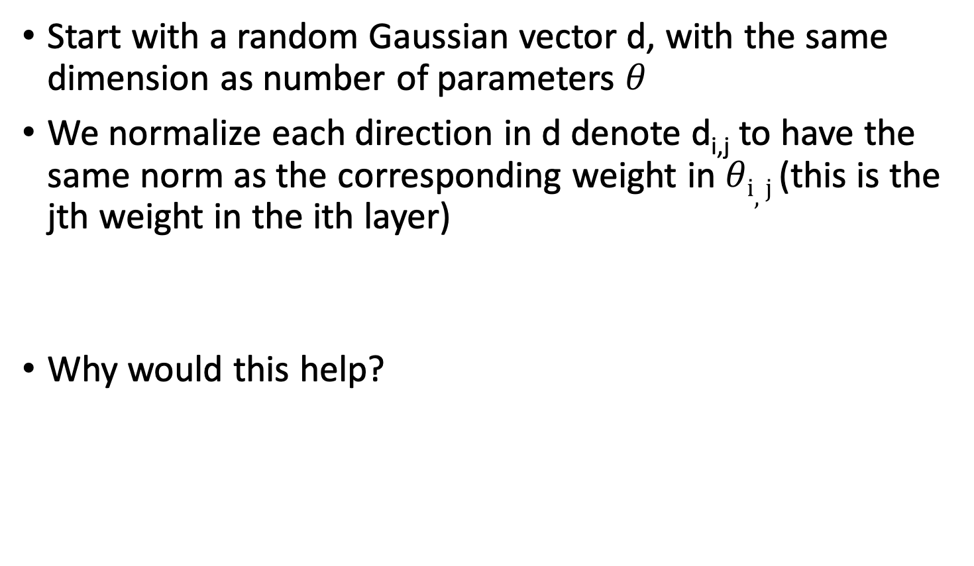
Filter-wise Normalization
Start with a random Gaussian vector d, with the same dimension as number of parameters $θ$
We normalize each direction in d denote d_{i,j} to have the same norm as the corresponding weight in $θi,j$ (this is the jth weight in the ith layer)
Why would this help?

Slide 8
Scale Invariance in RELU Nets
In a RELU network if weights in one layer are all multiplied by 10 and weights in the next layer are all divided by 10, network performance remains the same
Even more prominent during batch normalization regularization
Output of each layer is normalized before going to the next layer
Without the filter-wise normalization A neural network with large weights may appear to have a smooth and slowly varying loss function
Perturbing the weights by one unit will have very little effect on network
However, if the weights are much smaller than one, then that same unit perturbation may have a catastrophic effect, making the loss function appear quite sensitive to weight perturbations.

Slide 9
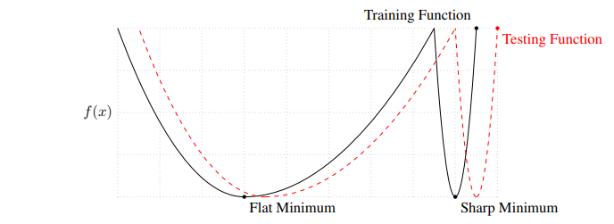
Flat Minima minima are thought to generalize better
Flatness definitions are not scale invariant

Slide 10
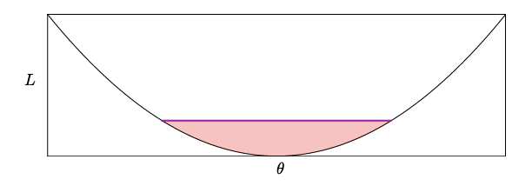
Volume
Height vs volume of red area is a measure of sharpness
There have been many attempts at scale invariant definitions

Slide 11
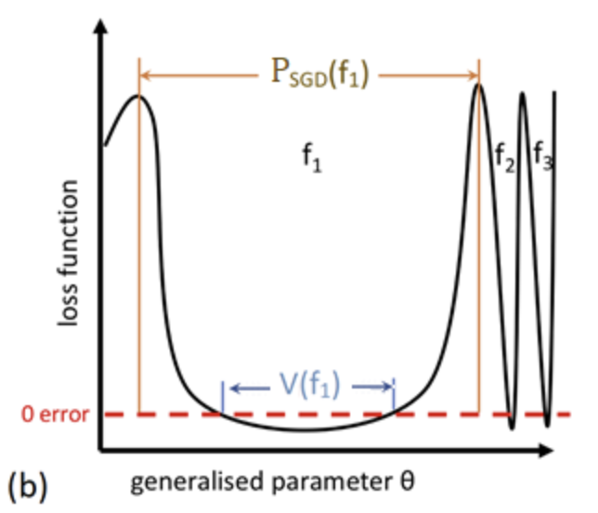
Volume of minima argument
Can think of the loss landscape as a function space
Space of functions that are consistent with the minima and the probability of finding them with SGD can also be used

Slide 12
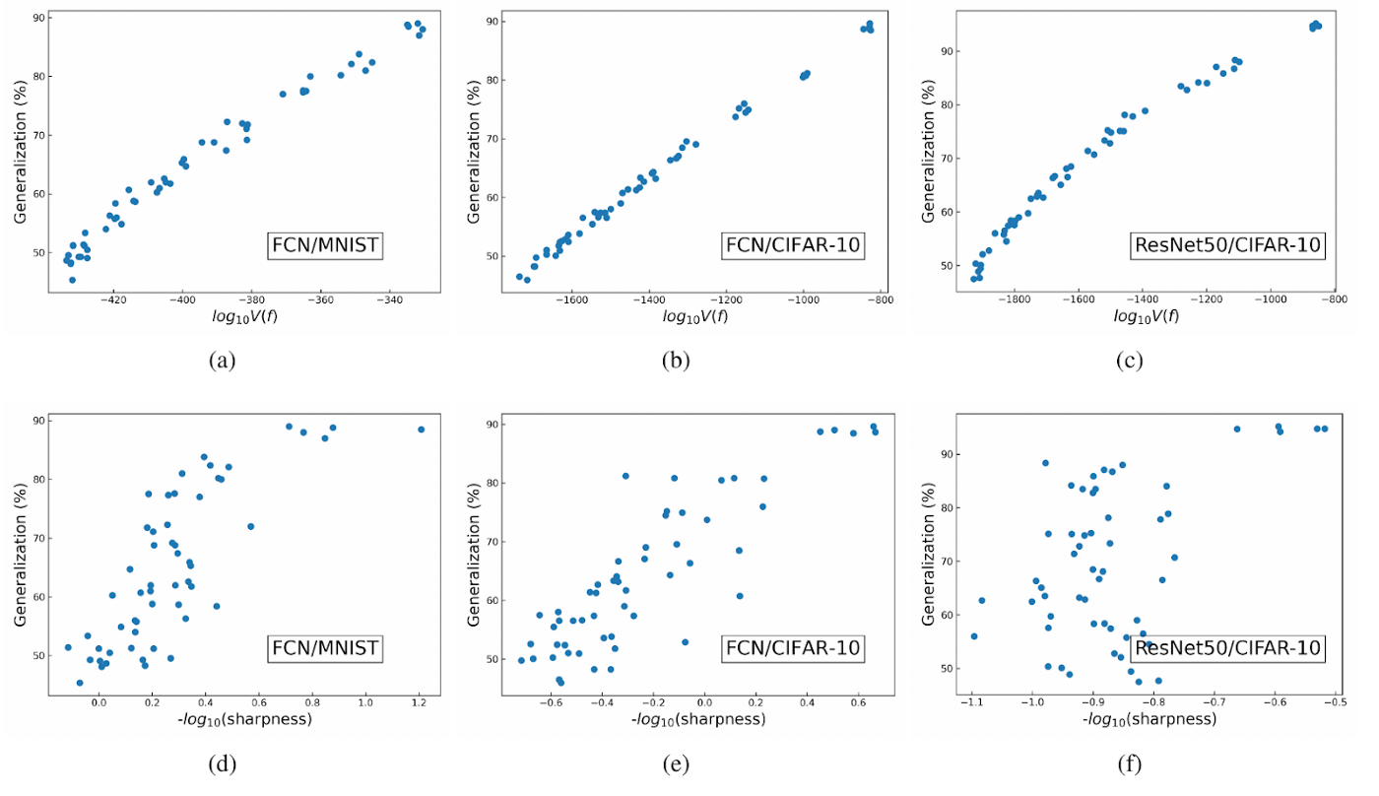
Empirical Correlation

Slide 13
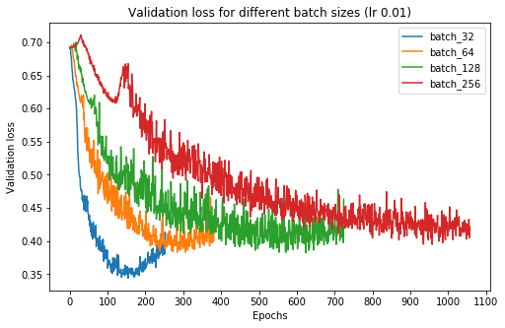
Large batch vs small batch training
Training SGD with large batches has been associated with sharp minima, slow training
Small batch training is thought to lead to more generalization and faster training

Slide 14
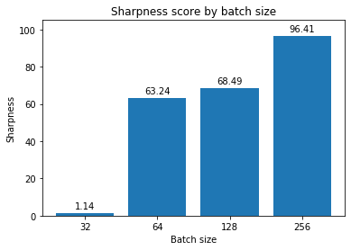
Reasons
Slow movement because of canceling directions
Stochasticity of small batches gets out of local minima
Tend to generalize to flatter minima

Slide 15
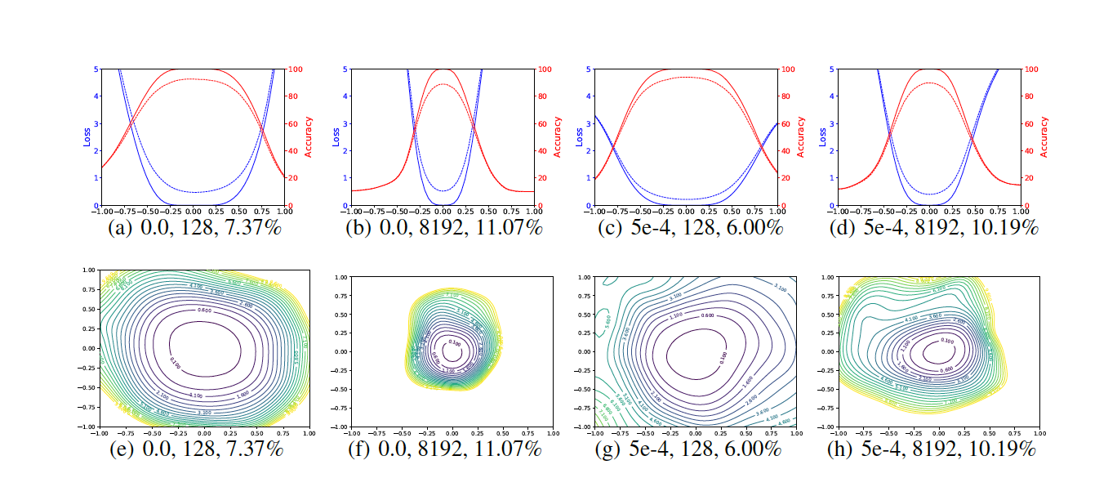
SB produces flatter Minima

Slide 16
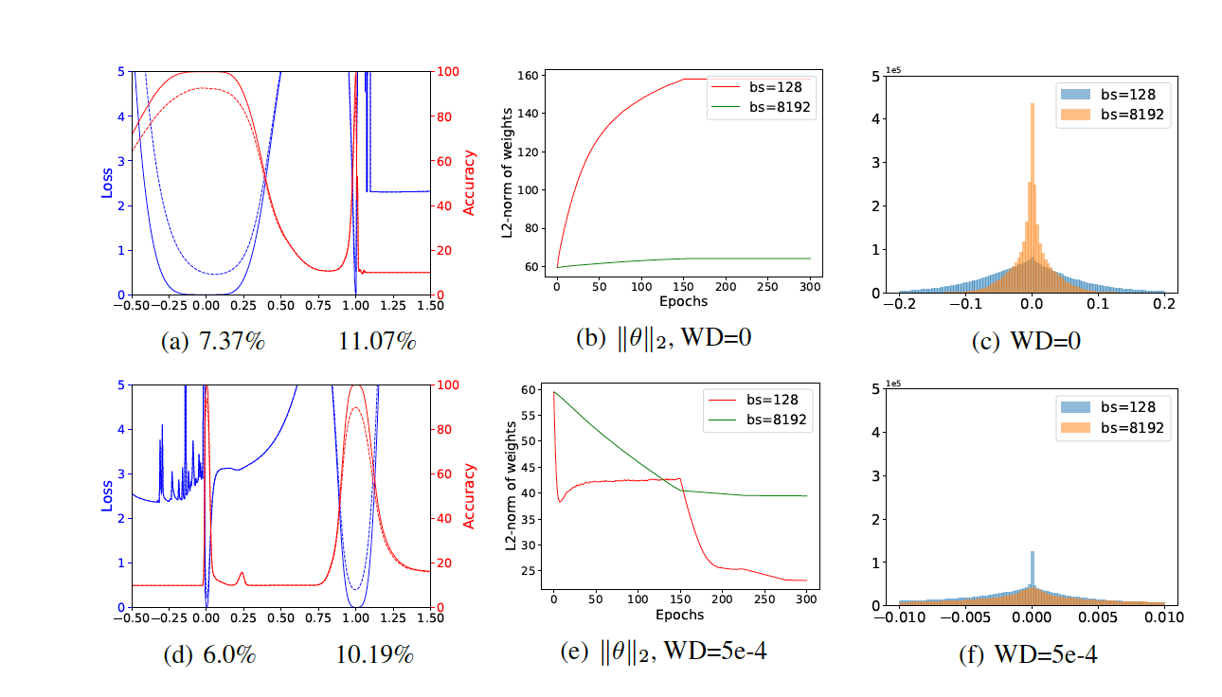
Reaffirms SB vs LB Hypothesis
Some works disputed the flat vs sharp loss landscape hypothesis, but visualization reaffirms it

Slide 17
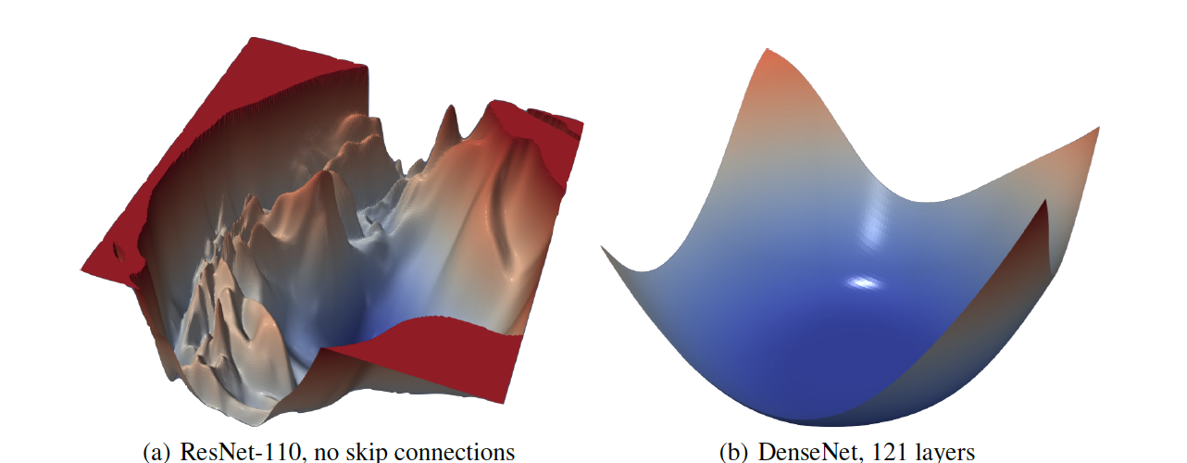
Provides Insights on Trainability
Loss surfaces of ResNet and DenseNET 121 layers shows which is easier to train
https://losslandscape.com/

Slide 18
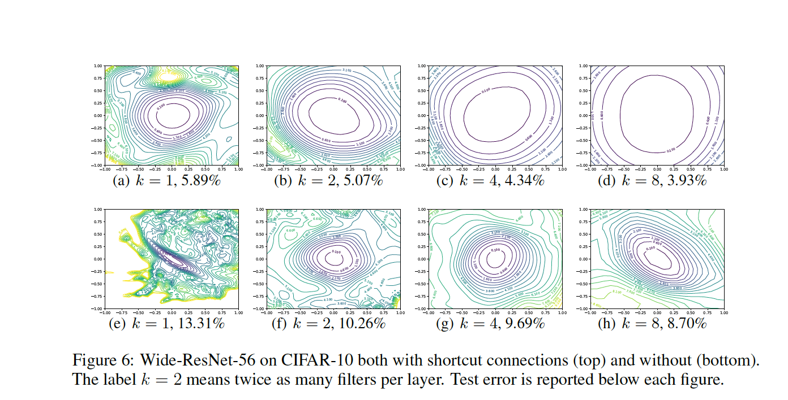
Wide vs Narrow Networks
Wide networks converge to wider basins

Slide 19
Exploring the Geometry and Topology of Neural Networks Loss Landscapes
Stefan Horoi
Symposium on Intelligent Data Analysis (IDA) 2022

Slide 20
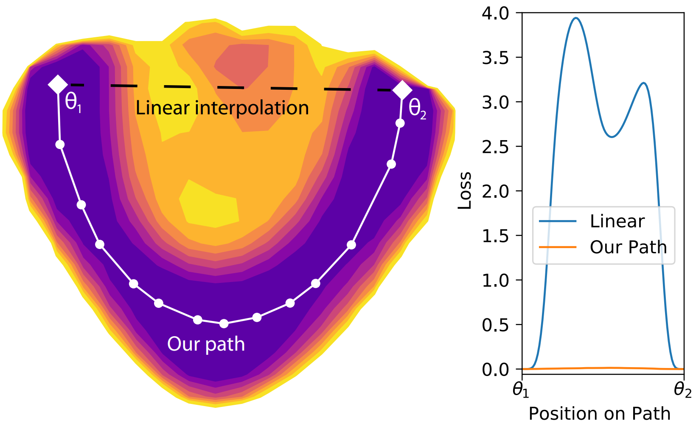
Existing methods cannot properly visualize complex high-dimensional loss
landscape geometric characteristics
Current loss landscape visualization methods are limited by:
Their linear nature
The small number of dimensions sampled and visualized (1 or 2)
[Draxler et al., 2018]

Slide 21
Proposed method:
Visualizations based on PHATE dimensionality reduction
Quantification of topological activity using computational homology
Dynamical “Jump and Retrain” loss landscape sampling

Slide 22
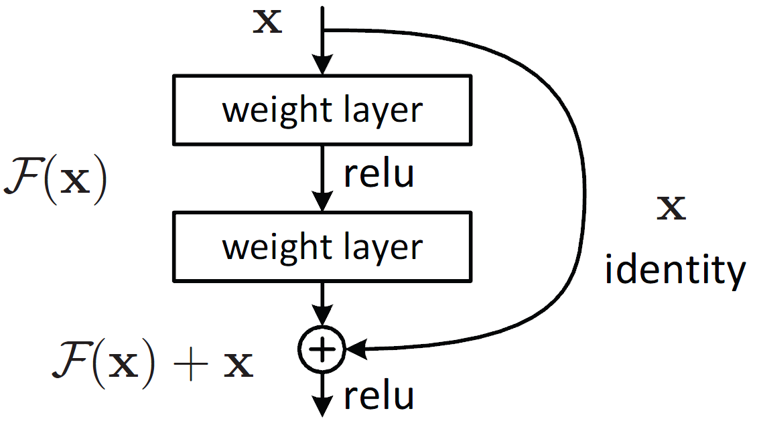
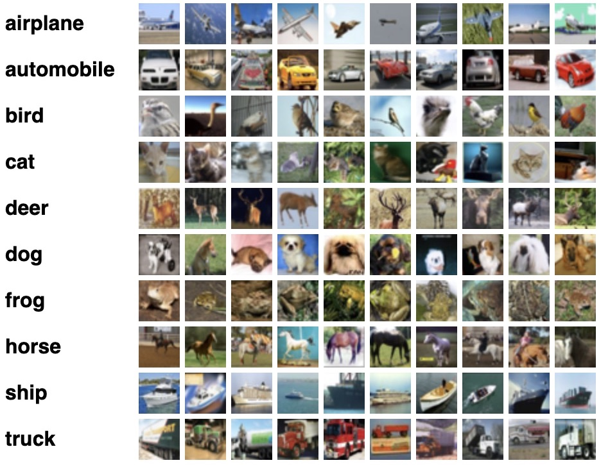
Experimental set-up
CIFAR10
[Krizhevsky, 2009]
Wide ResNets
[Zagoruyko & Komodakis, 2016]
108 networks: same initalization
{10, 16, 22}
Depth
{1,2}
Width
{0, 0.0001, 0.001}
Weight decay
{32, 128, 512}
Batch size
{no data augmentation,
random flips and crops}

Slide 23
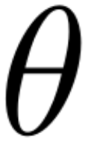

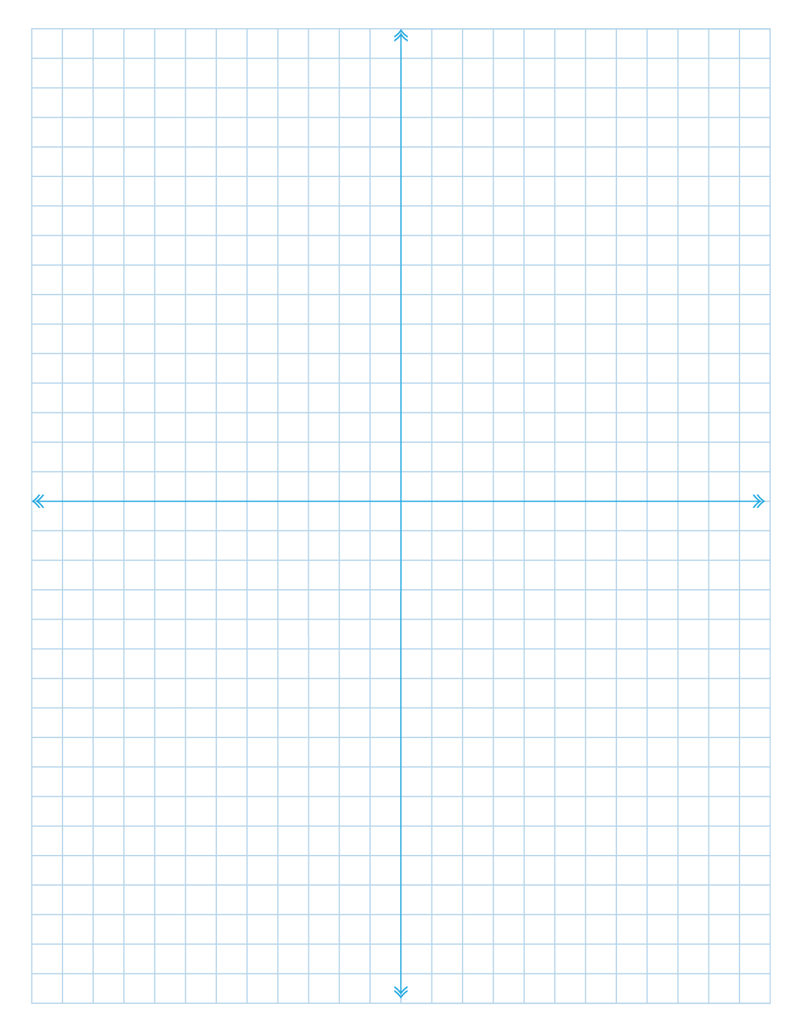
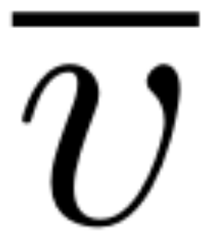
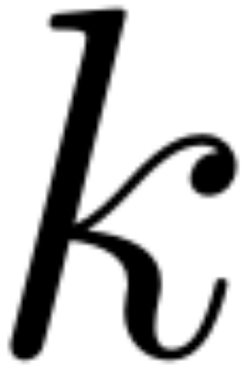
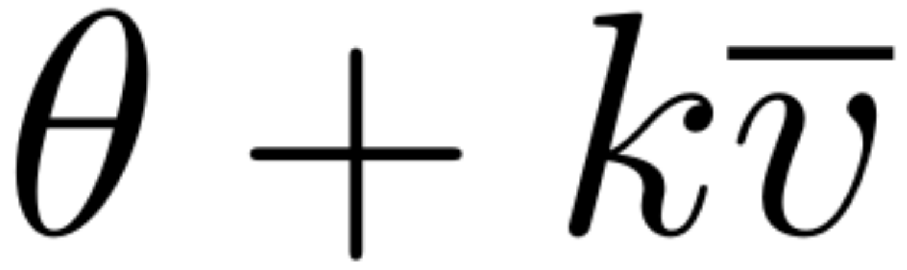
“Jump and retrain” sampling of relevant low-loss manifolds on the loss landscape that are reachable during training
Given a minimum:
Parameter space
1. Pick a random direction and filter-normalize it:
2. Pick a step_size in {0.25, 0.5, 0.75, 1}:
3. Set the ANN parameters to be:
4. Retrain the ANN and record data
Repeat for 4 or 5 directions and all step sizes
Low loss regions of the loss landscape

Slide 24
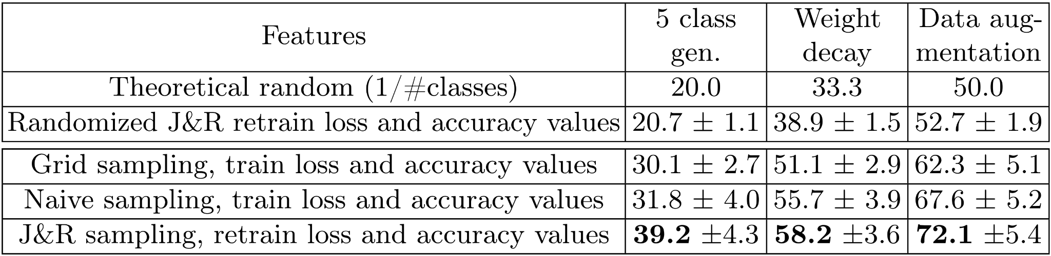
“Jump and retrain” sampling holds more information about generalization and training than past methods
Jump and retrain
Grid sampling
Naive sampling
Mean accuracy and standard error of 11 simple classifiers:

Slide 25
Dynamical “Jump and Retrain” loss landscape sampling
Visualizations based on PHATE dimensionality reduction
Quantification of topological activity using computational homology
Holds more information about generalization and training than past methods

Slide 26
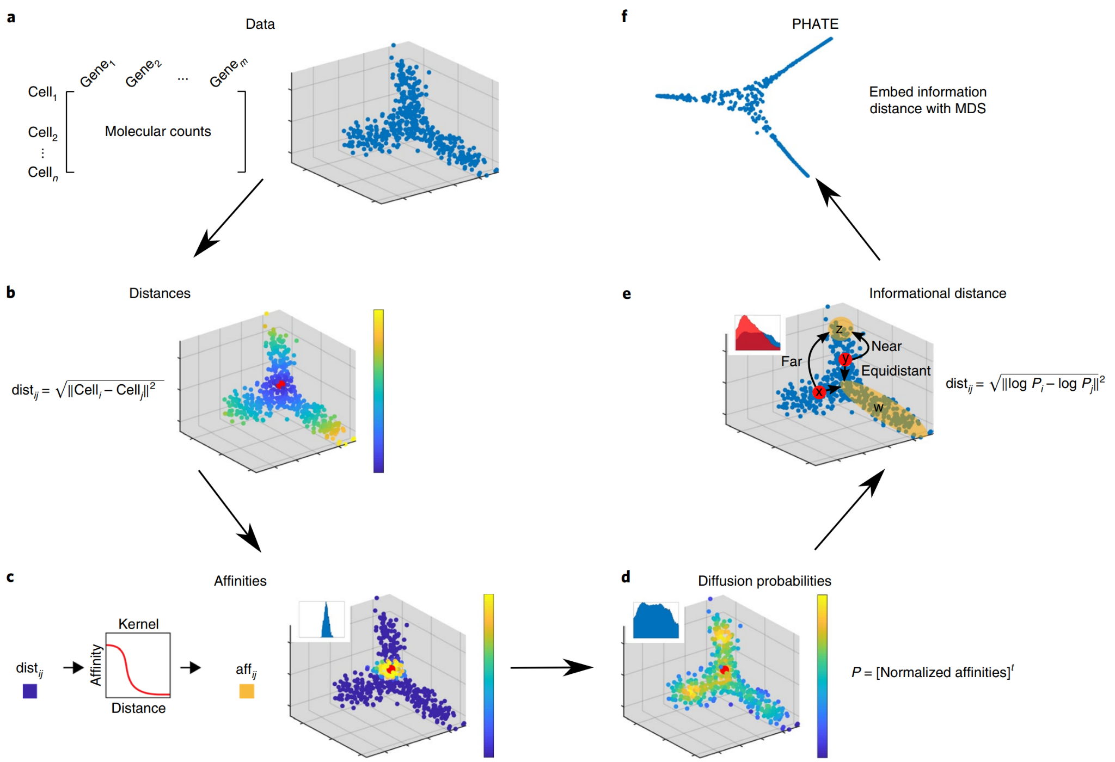
Dimensionality reduction using PHATE
[Moon et al., Nature Biotechnology, 2019]
a) Given a data matrix
b) Compute pairwise distances
c) Transform distances to affinities to encode local information
d) Learn global relationships via diffusion
e) Encode the learned relationships using the potential distance
f) Embed the potential distance information into low dimensions via MDS

Slide 27
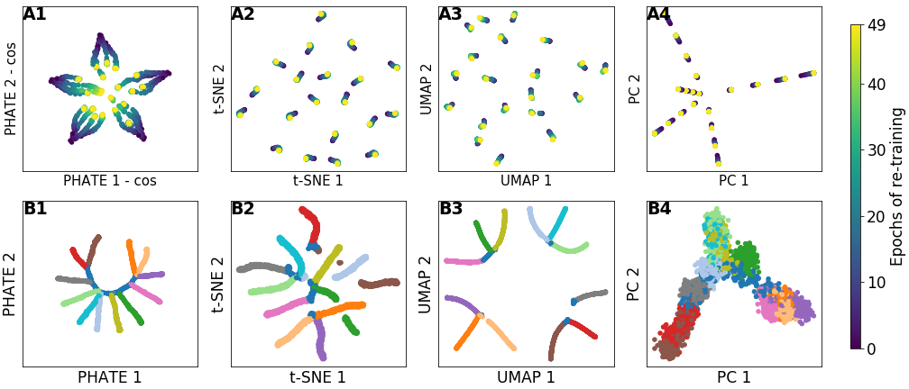
PHATE visualizations better preserve data variability and global structure
PHATE (with cosine distance) improves on past, linear, methods by:
Capturing variance in sampled data from all relevant dimensions and embedding it in a low-D space
(as would’ve done other modern dimensionality reduction methods…)
Preserving high-D trajectories and global structures of data

Slide 28
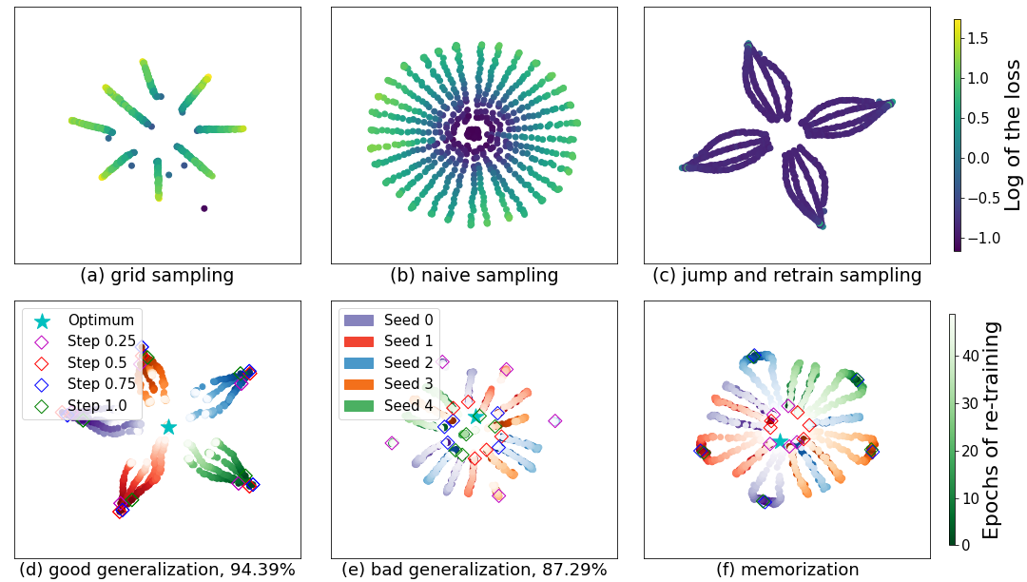
PHATE visualizations reveal stark differences between networks that memorize (or overfit) vs. ones that generalize
J&R sampling data results in more informative visualizations and correctly samples low loss regions surrounding minima

Slide 29
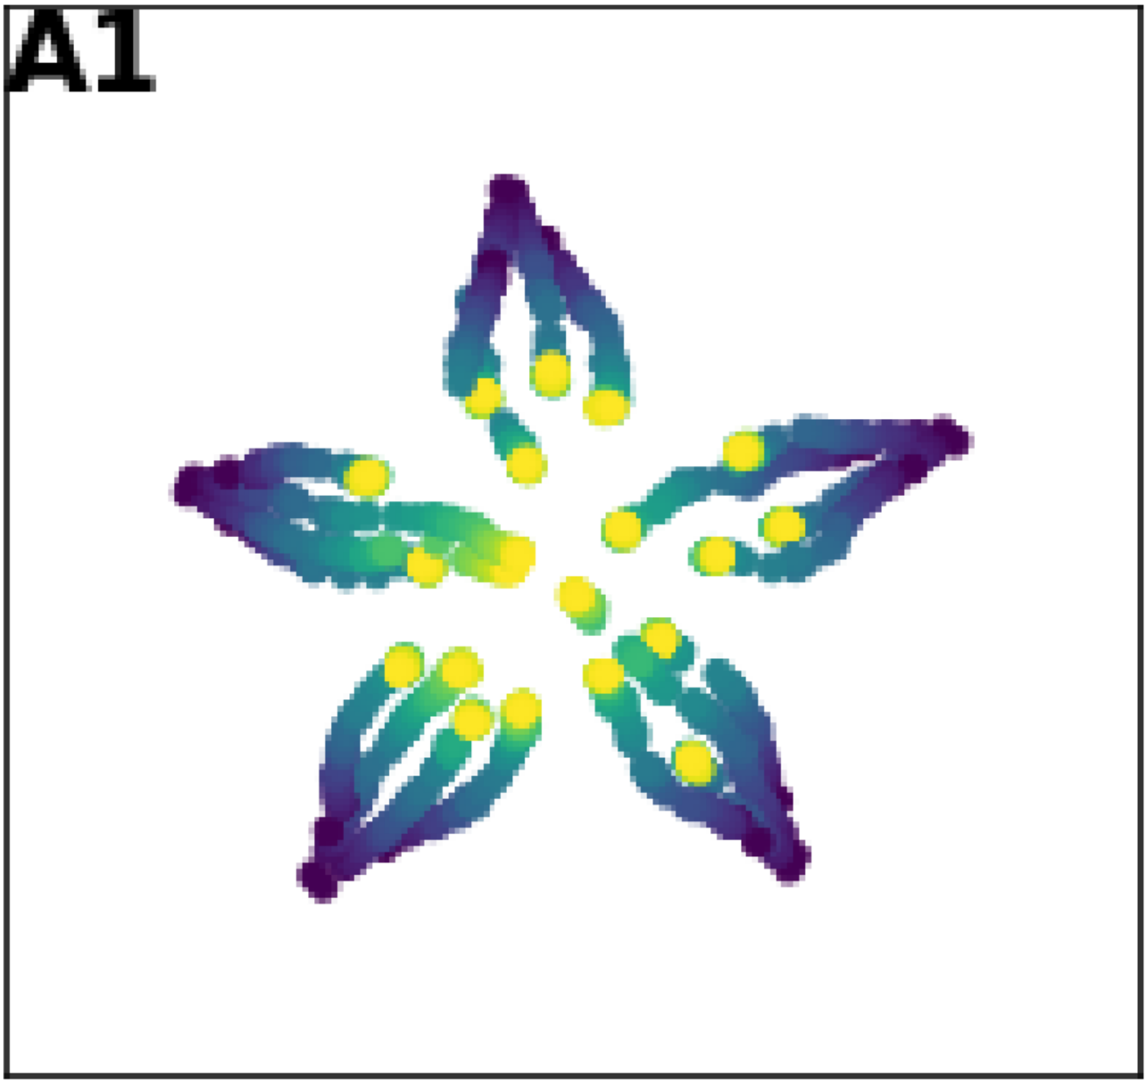
Visualizations based on PHATE dimensionality reduction
Dynamical “Jump and Retrain” loss landscape sampling
Quantification of topological activity using computational homology
Highlights geometric differences in the low loss manifolds around different minima
Holds more information about generalization and training than past methods

Slide 30
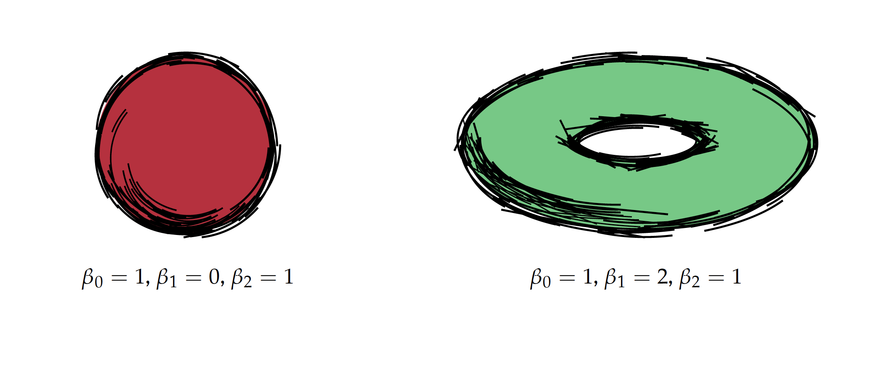
Characterization of D-dimensional Holes

Slide 31
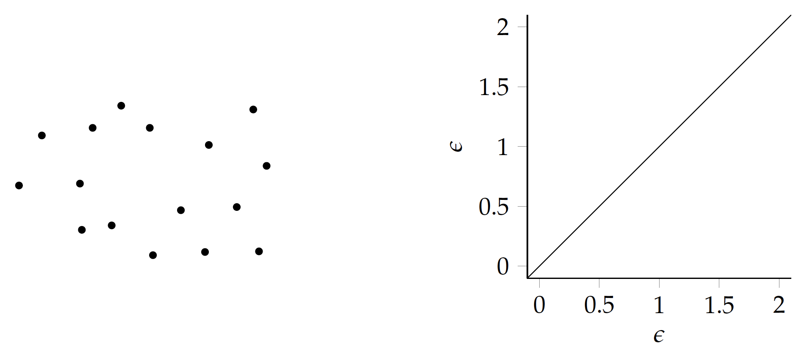
Computational Homology (Vietoris Rips Filtration)

Slide 32
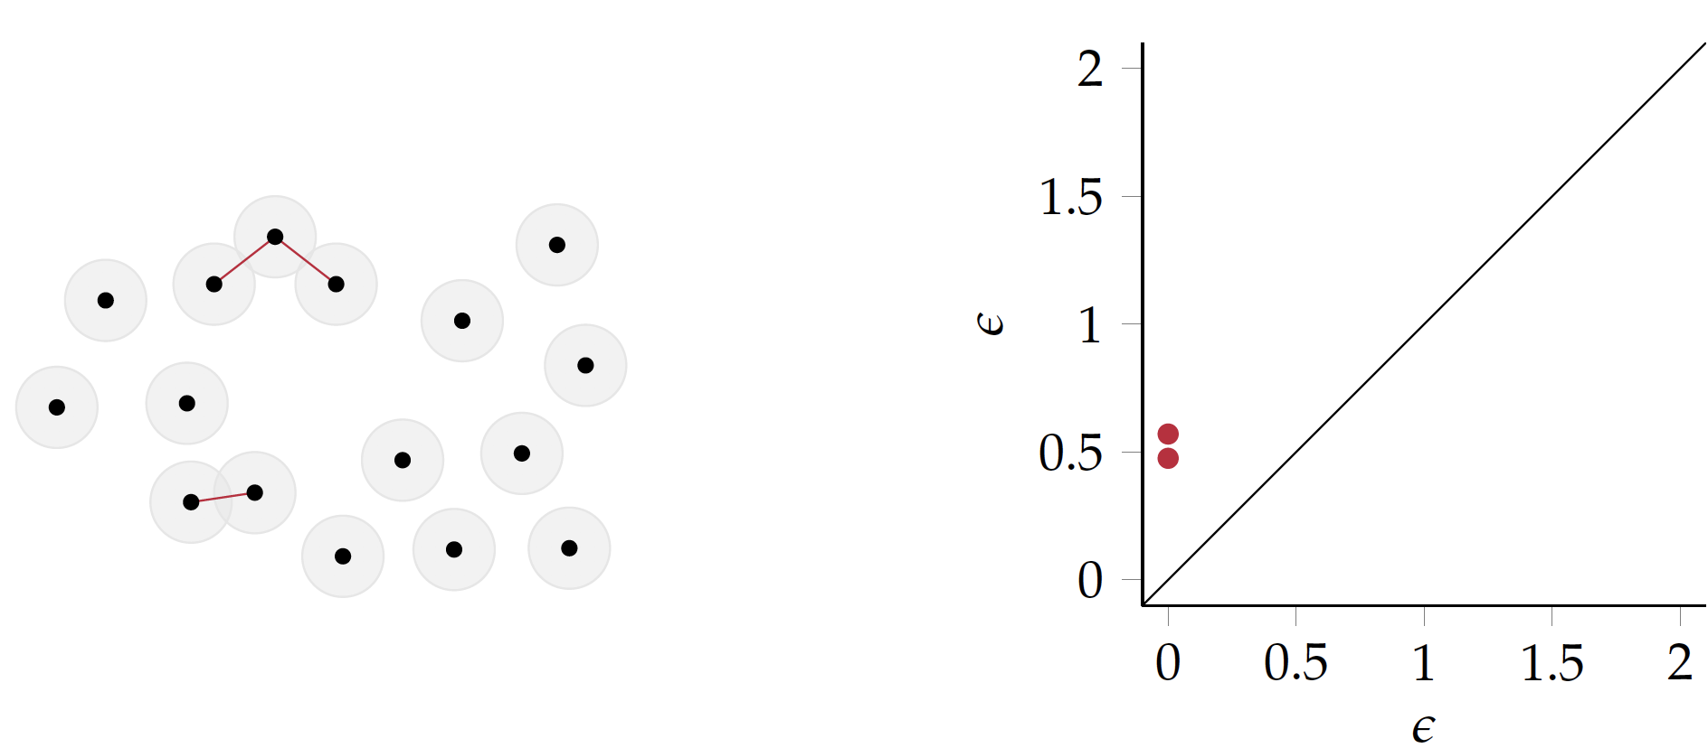
Computational Homology (Vietoris Rips Filtration)

Slide 33
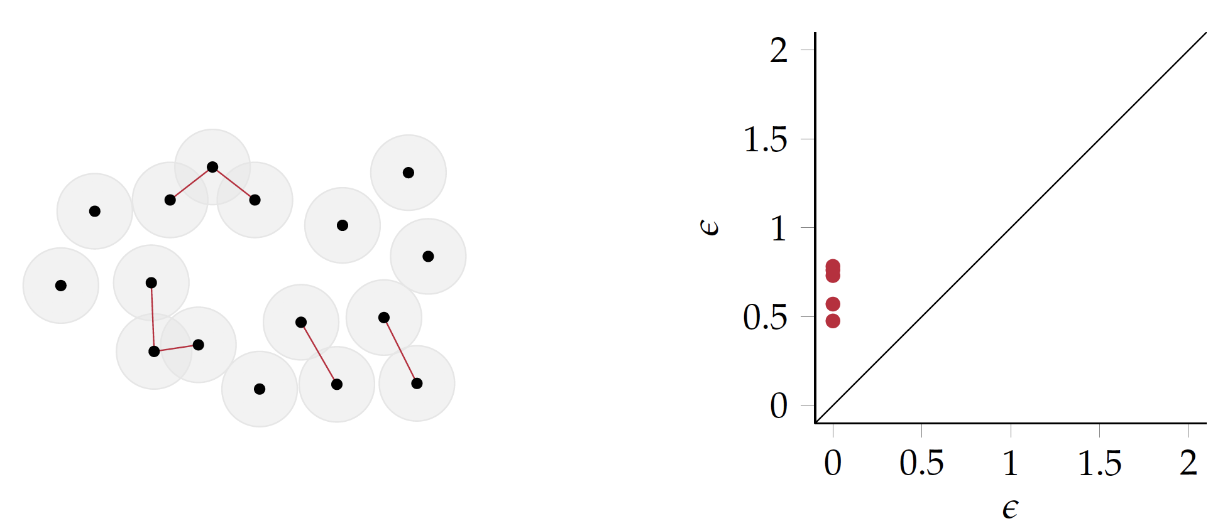
Computational Homology (Vietoris Rips Filtration)

Slide 34
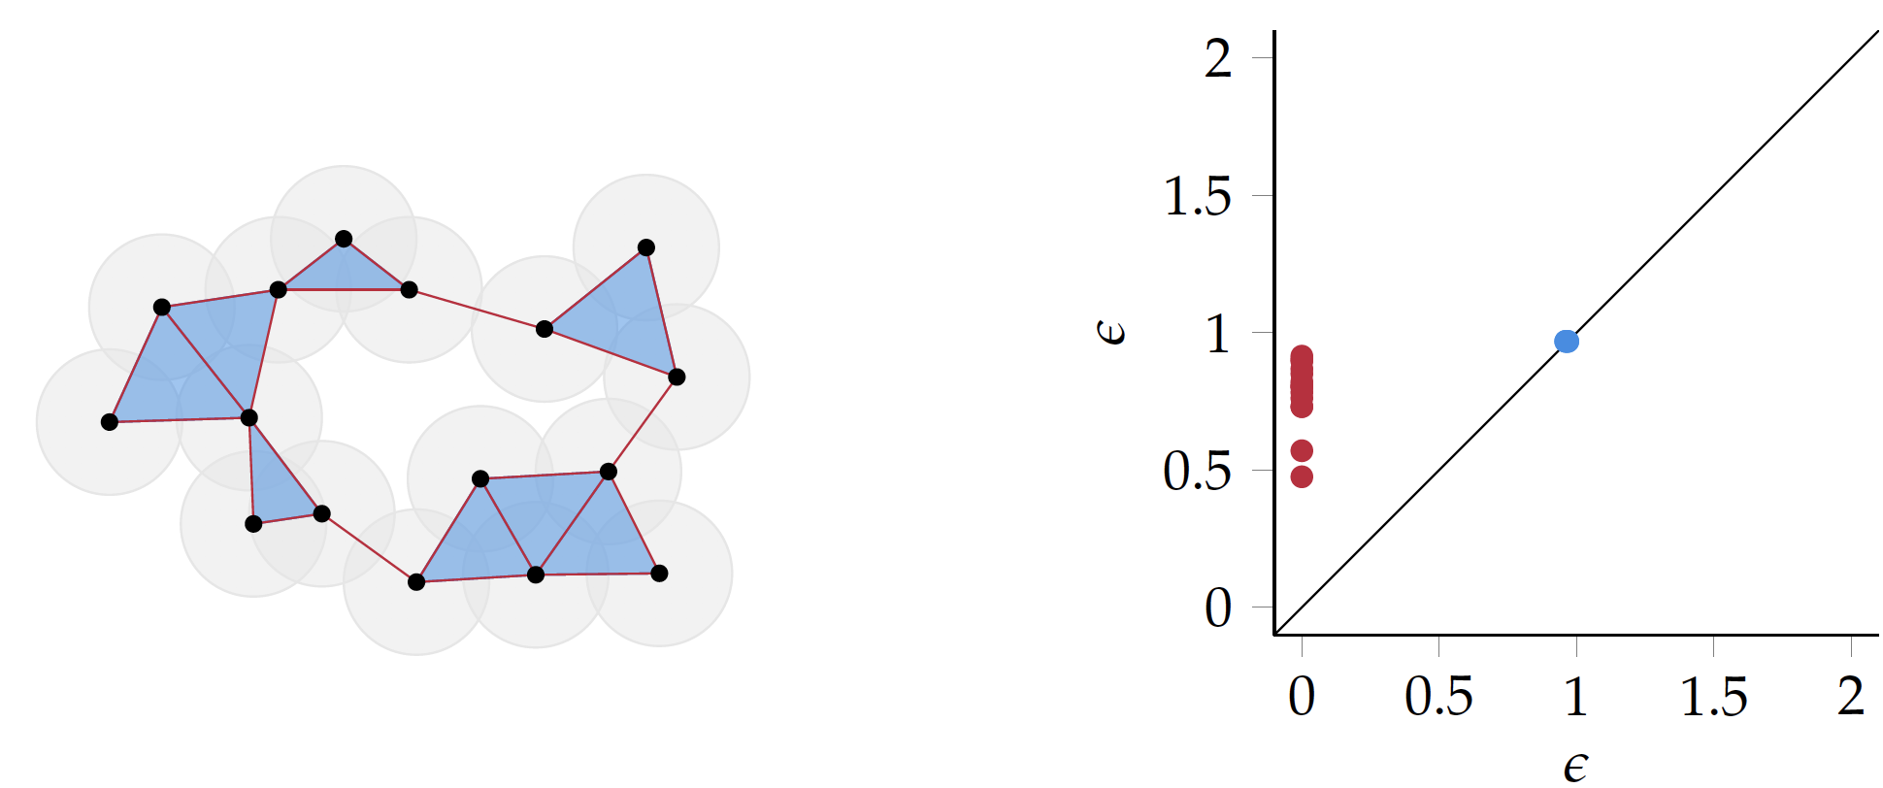
Computational Homology

Slide 35
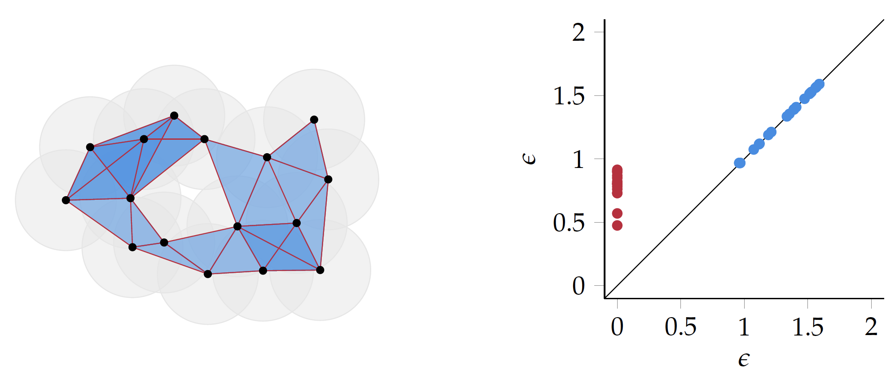
Computational Homology

Slide 36
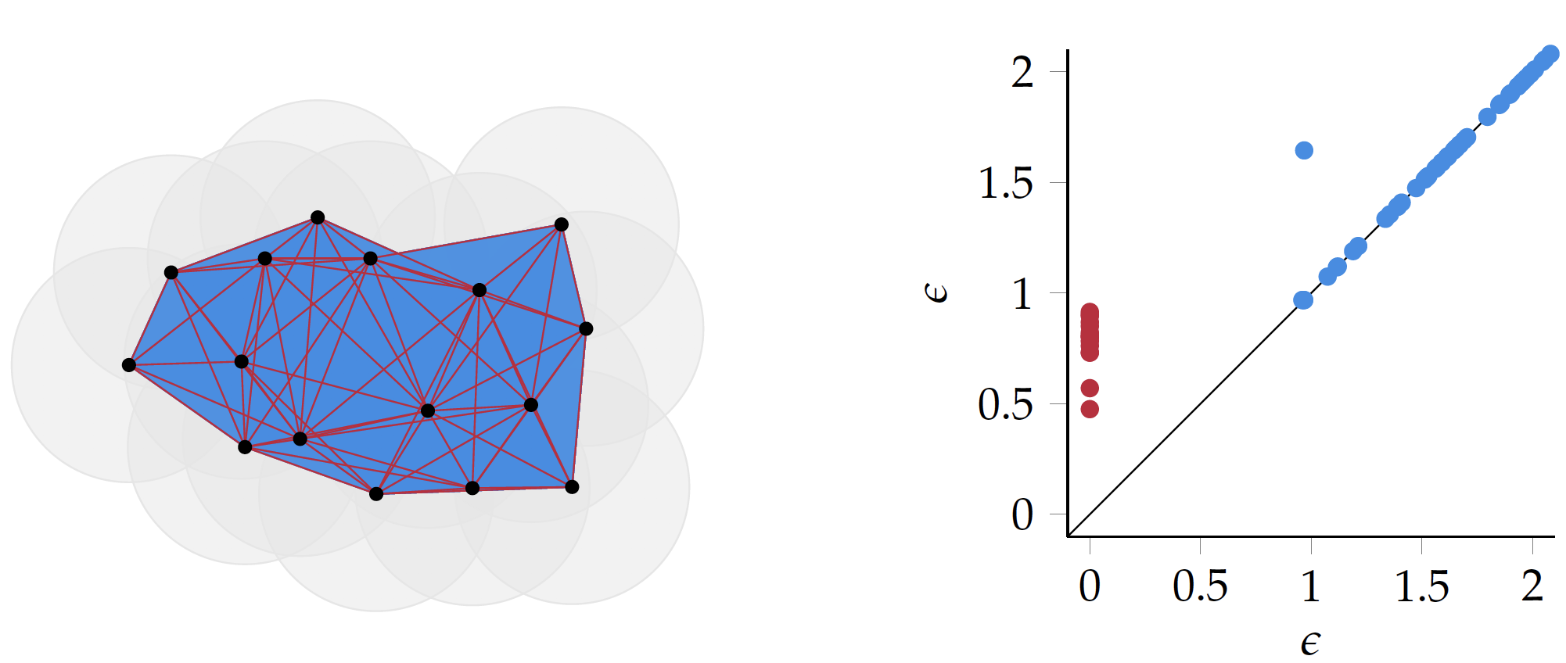
Computational Homology

Slide 37
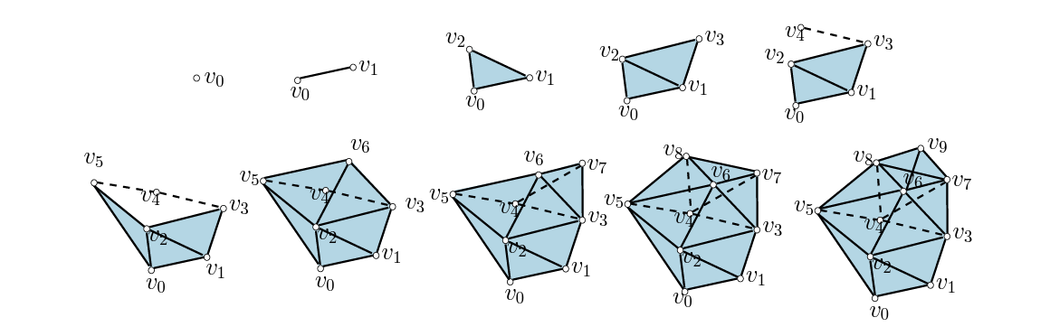
Vertex Value Filtration

Slide 38
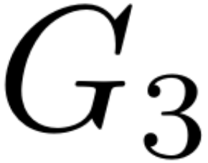
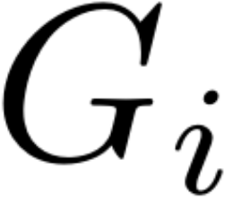

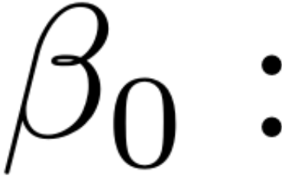
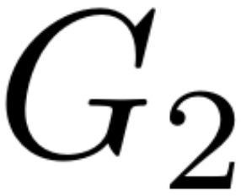
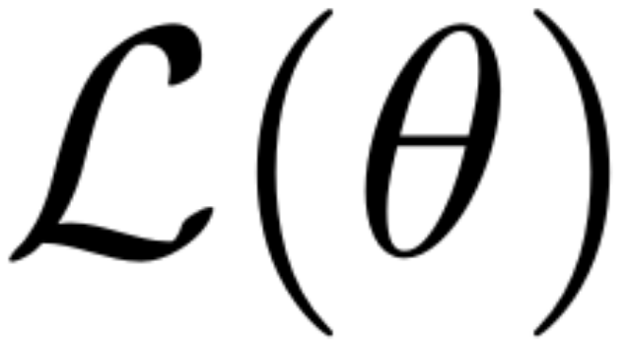
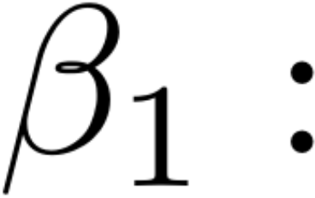
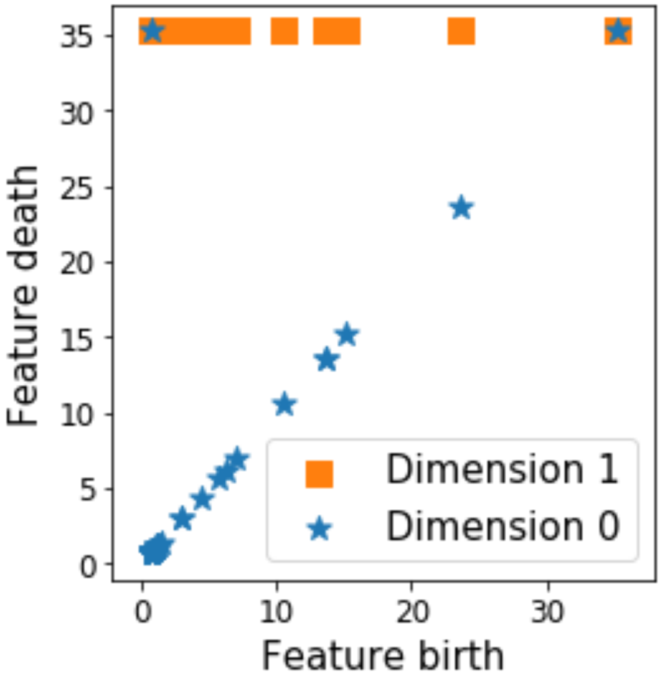
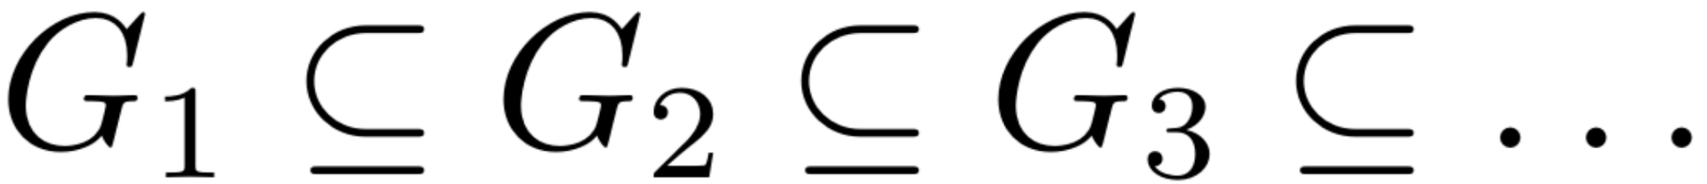
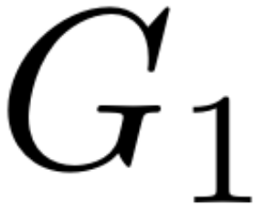
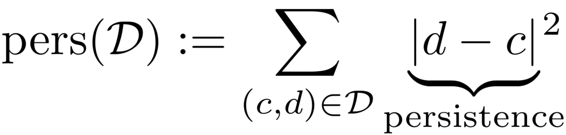
Quantifying the topological features of the J&R sampled trajectories using computational topology
1. Construct 20-NN graph using PHATE distances
2. Assign to each node the associated loss value
3. Create a graph filtration by increasing the loss
4. Compute topological features for each
# of connected components
# of cycles
Persistence diagrams keep track of (creation, death) per feature
Total persistence:

Slide 39
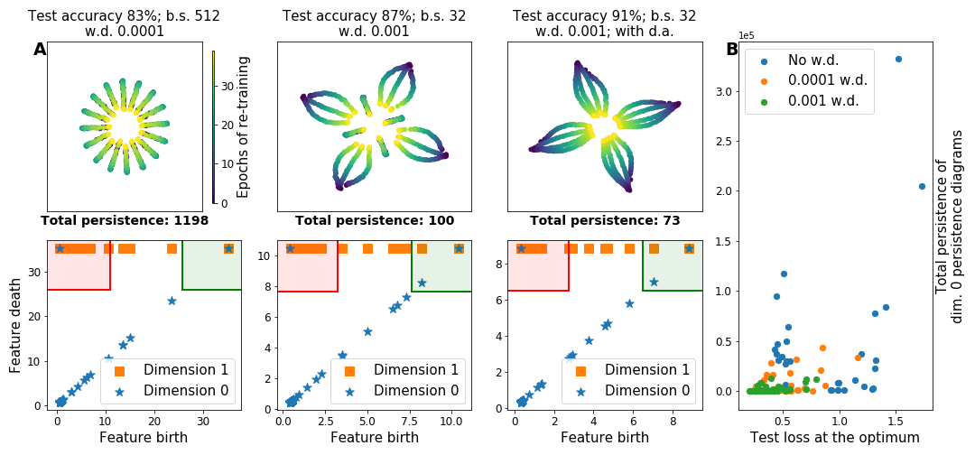
Minima that generalize well are surrounded by low loss manifolds with less topological activity

Slide 40

Visualizations based on PHATE dimensionality reduction
Quantification of topological activity using computational homology
Dynamical “Jump and Retrain” loss landscape sampling
Future directions
Dimensionality reduction methods that better take into account the time dependency of the sampled data
Principled approaches for the empirical analysis of loss landscapes
A lot more work is required!
Highlights geometric differences in the low loss manifolds around different minima
Minima that generalize well are surrounded by regions of low topological activity
Holds more information about generalization and training than past methods

Slide 41
Further reading
Draxler et al. 2019 Essentially No Barriers in Neural Network Energy Landscape
Li et al. 2018 Visualizing the Loss Landscape of Neural Nets
Dinh et al 2019 Sharp Minima Can Generalize For Deep Nets
Keskar, Nocedal, Mudigere, Smelyanskiy, and Tang. On Large-Batch Training for Deep Learning: Generalization Gap and Sharp Minima. https://arxiv.org/pdf/1609.04836.pdf
Li, Xu, Taylor, Studer, and Goldstein. Visualizing the Loss Landscape of Neural Nets. https://papers.nips.cc/paper/7875-visualizing-the-loss-landscape-of-neural-nets.pdf.
Horoi et al. Exploring the Geometry and Topology of Loss Landscapes https://arxiv.org/abs/2102.00485

